Slide 1

IAFEI: the worldwide voice of CFOs
国际财联：全球CFO的声音

Slide 2
IAFEI : the worldwide Association of
National Financial Executives Institutes
国际财务总裁协会联合会

Slide 3

WHAT IS IAFEI?国际财联简介
A worldwide professional Association of
National Financial Executives Institutes established in 1969 成立于1969年
A private non-profit and non-political Association 依瑞士民法成立,注册地瑞士
Organized under the Swiss Civil Code and legally domiciled in Switzerland
Its founding members were the Financial Executives Institutes of Argentina,
Australia, Belgium, France, Germany, Italy, Mexico, Peru, Philippines, Spain, United Kingdom of Great Britain and the combined Institutes of USA and Canada
由不同国家和地区的12个CFO专业组织发起成立
At present, IAFEI has16 members with a total membership of over 12,000 financial executives 现有会员组织16个，会员12000人
The IAFEI Secretariat is currently domiciled in the Philippines 秘书处设在菲律宾

Slide 4
















IAFEI MEMBER INSTITUTES会员组织
Austria
Belgium
C hina
C hinese Taiw an
ÖPWZ Forum F inanzen
Financial Executives Institute of Belgium
China Association of Chief Financial Officers
F i nancial Exec utives Institut e of C hinese Taiw an
F rance
German y
Indonesia
Israel
A ssocia tion Na tionale des D i rec t eurs F inanciers et de Contrôle de Gestion
Gesellschaft für Finanzwirtschaft in der Unternehmensführung e.V.
Indonesia Financial Executive Association
Israeli C h ief F inancial O ffi cers Fo rum
Italy
Japan
Korea
Me xico
A ssociazione Nazionale
D i rett ori Amministra tivi e F inanziari
Japan A ssocia tion f or
C hief F inancial O fficers
Instituto Me xic ano de Ejec utivos de
F i nanzas
Korea Association for Chief Financial Officers
Philippines
Poland
Sp a i n
V i etnam
F inancial Exec utives Institut e of the Philippines
S towar z yszenie D yrektorów Finansow ych
A sociación Espanola de Ejec u tivos de F i nanzas
V i etnam C h ief F inancial O fficers C lub

Slide 5
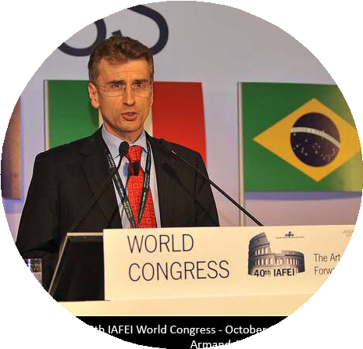
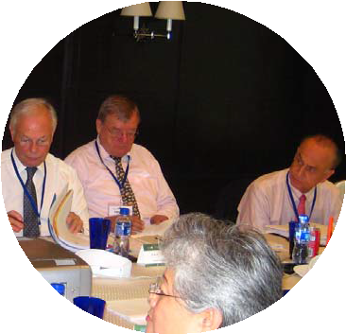

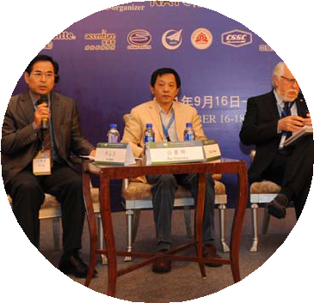
WHAT ARE THE BENEFITS OF JOINING IAFEI?
加入国际财联可以获得什么？
Opportunities for institutional sponsorship
and speakership engagements at key events
for CFOs around the world大会演讲、商业赞助
Promotion of ethical and best practices of financial management throughout the world
财务管理道德准则与最佳实务的提升
Networking opportunities 人脉资源
A wider understanding of financial practices
throughout the world and furtherance of
international compatibility and evolution
对全球财务实务融合与发展的更宽泛了解

Slide 6
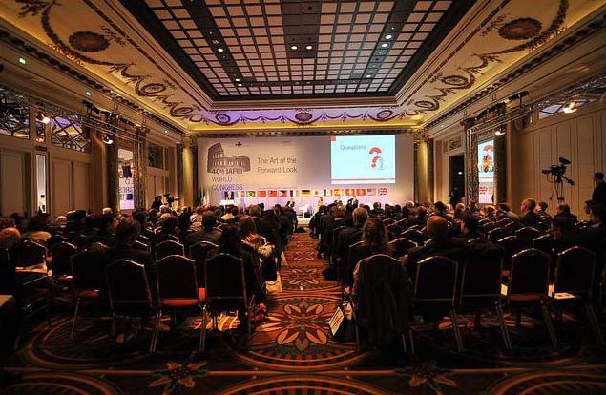
WHAT ARE THE ACTIVITIES OF IAFEI? 开展活动
IAFEI World Congress
Regional Asian Conference
IAFEI Quarterly and Special Issues
Technical Working Committees
世界大会、亚洲峰会、电子季刊和特刊、专业委员会

Slide 7



WHAT ARE THE ACTIVITIES OF IAFEI?开展活动
IAFEI World Congress 国际财联世界大会
is an annual event organized by a host member institute where financial executives from all over the world convene to participate in discussions of topics and exchange ideas relating to the CFOs concerns in the current global situation.

Slide 8

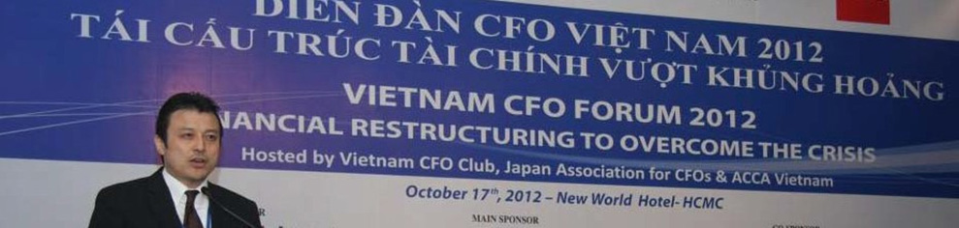
WHAT ARE THE ACTIVITIES OF IAFEI?开展活动
IAFEI Regional Asian Conference 国际财联亚洲峰会
is an annual event organized by (an) Asian member institute(s) to promote sharing of local and international experiences, skills, knowledge and information among Asian CFOs.

Slide 9

WHAT ARE THE ACTIVITIES OF IAFEI?开展活动
IAFEI Quarterly & Special Issues国际财联电子季刊和特刊
The electronic professional journal of IAFEI released quarterly.
Articles include contributions from member institutes, Technical Working Committees and other financial sources.
Offered to all member institutes and their members for free.
Downloadable from the IAFEI website at www.iafei.org/quarterly.html.

Slide 10
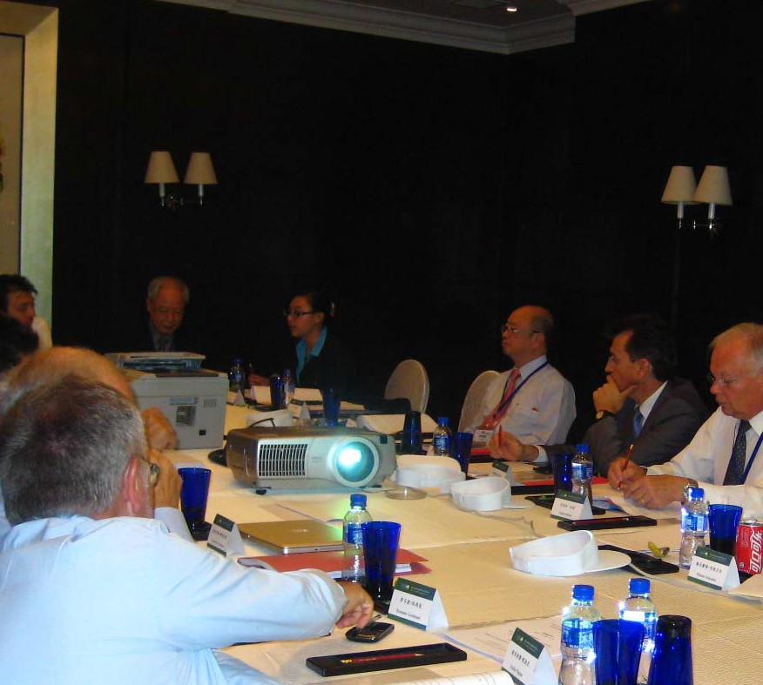
WHAT ARE THE ACTIVITIES OF IAFEI?开展活动
Technical Working Committees:
四个专业委员会
IFRS Committee
International Tax Committee International Treasury Committee
International Observatory of Management Control Committee

Slide 11

WHO CAN JOIN IAFEI?加入条件
Members会员条件
A national institute largely composed of financial and
control executives of leading business concerns who have a common interest in the techniques of financial management, financial accounting, reporting and in maintaining business enterprises on a healthy basis in the face of changing business conditions.
Membership in such national institutes should be open to executives performing the policy setting functions of a financial executive in a company of sufficient size.

Slide 12

WHO CAN JOIN IAFEI?加入条件
Affiliates准会员条件
In a country where there is no national institute, groups of
financial and control executives as previously described may apply for affiliation with IAFEI.
If application is accepted, affiliates are entitled to participate in IAFEI’s activities and may nominate its President who will be a member of the Board of Directors.

Slide 13

Area Presidents地区主席
HOW TO JOIN IAFEI?怎样加入国际财联
Americas 美洲地区
Juan ALFREDO ORTEGA (IMEF–Mexico)
Email: juan_ortega@mcgraw-hill.com
Phone: +52 (55) 1500 51.00 x4471
Dir. +52 (55) 5081.4471
Asia 亚洲地区
Yoshiyuki HIJIKATA(JACFO-Japan) Email: hijikata@cfo.jp
Phone: + 81‐3‐3556‐0931
Mobile: + 81‐90‐6501‐5093
Europe, Middle East & Africa
欧洲、中东及非洲地区
Armand ANGELI (DFCG-France) Email: armand.angeli@orange.fr Mobile: +33 6 0984 3969
Executive Director 国际财联执行理事
Helmut SCHNABEL
Email: Helmut.Schnabel@asecuris-asset.com
Tel. no.: +49 69 7707 6606 Fax: +49 69 3535 1512
IAFEI Secretariat 国际财联秘书处
1003 10th Floor, Pasong Tamo Tower
2210 Don Chino Roces Ave., Makati City 1231, Philippines Head of Secretariat - Lynn ANGELES
Email: iafeiheadofsecretariat@yahoo.com Tel. no.: +632 728 0315
www.iafei.org

Slide 14




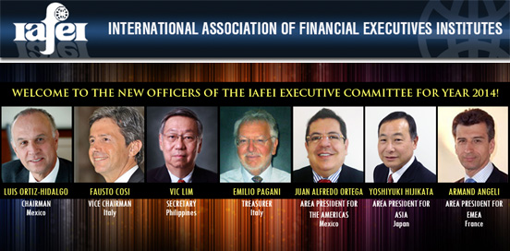
FOR MORE INFORMATION更多信息
http://www.iafei.org
IAFEI Secretariat
1003 10th Floor, Pasong Tamo Tower 2210 Don Chino Roces Ave., Makati City 1231, Philippines
Head of Secretariat - Lynn Angeles Email: iafeiheadofsecretariat@yahoo.com
Tel. no.: +632 728 0315
www.iafei.org

